Slide 1


Project Title : Insurance Data Analytical Project
Group -2
Team Members : 1. Tiny Ajesh
2. ningappa
3. Manisha Sachin Aute

Slide 2

Agenda
Introduction
Tools & Technologies ( Excel, Power BI ,Tableau, MySQL )
Methodology
Dashboard Previews
Challenges & Solutions
Conclusion

Slide 3

Introduction
Insurance project (Data Sets) :
Have a Data Sets Are :
* Brokerage
* Fees
* Individual Budget
* Invoice
* Meeting
* Opportunity
2. Brief overview of the insurance project :
In This Data Set Having More Fact Table And Only 1- or 2-Dimension Tables . That’s The Reason More Complicated For Creating Data Modeling. Once we Understanding The Concept Very well Then Will Do Perfectly .
3. Purpose of using data analytics :
To convert raw data into meaningful insights that help in better decision-making, identifying trends, improving efficiency, enhancing customer experience, reducing risks, and driving business growth.
4. Scope Of Project :
They provide hands-on experience, build portfolio, improve skills, and increase job opportunities.

Slide 4





Tools And Technologies
Excel – Quick analysis, pivot tables, trend charts.
Power BI – Interactive dashboards and KPI monitoring.
Tableau – Visual storytelling and advanced data visualization.
SQL – Data extraction, cleaning, and transformation.

Slide 5

Methodology 1. Data Cleaning And Preprocessing
It is the process of removing errors, duplicates, and missing values, formatting data, and preparing it for analysis.
In Excel:
Use filters, conditional formatting, text functions, remove duplicates, handle blanks.
In SQL:
Use [UPDATE], [DELETE], [TRIM()], [IS NULL], [JOIN]s to clean, standardize, and organize data.
Purpose:
To make data accurate, consistent, and ready for analysis.
Visualization & Reporting :
It is the process of converting raw data into interactive charts, dashboards, and reports for better understanding and decision-making.
Power BI:
Connects to multiple data sources, creates dynamic dashboards, and shares insights.
Tableau:
Builds advanced visualizations, identifies patterns/trends, and supports storytelling with data.
Purpose:
To present data clearly, track KPIs, and help businesses make informed decisions.

Slide 6

2. Insights And Decision Making
Data analytics helps in finding patterns, trends, and useful information from raw data. These insights guide organizations to make accurate, faster, and evidence-based decisions, reducing risks and improving business growth.

Slide 7
Excel Dashboard

Slide 8
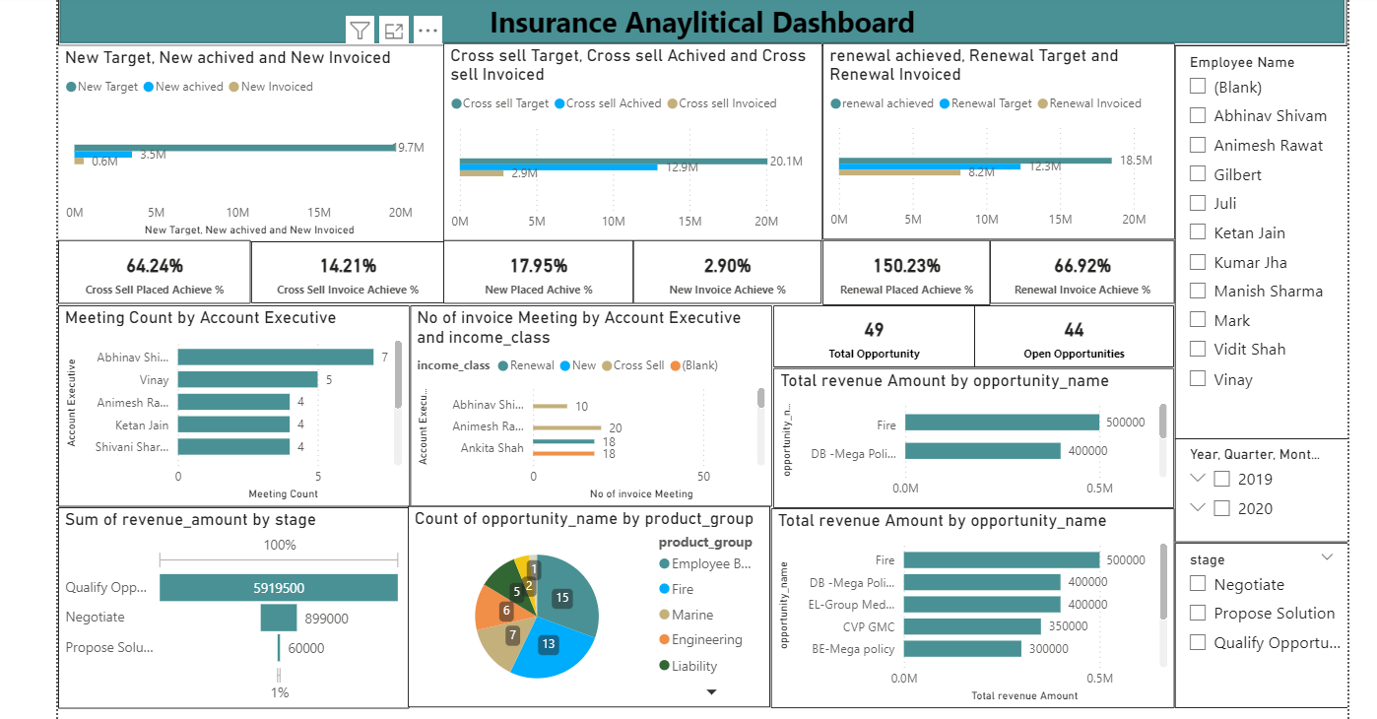
Power Bi Dashboard
Data analytics helps in finding patterns, trends, and useful information from raw data. These insights guide organizations to make accurate, faster, and evidence-based decisions, reducing risks and improving business growth.

Slide 9
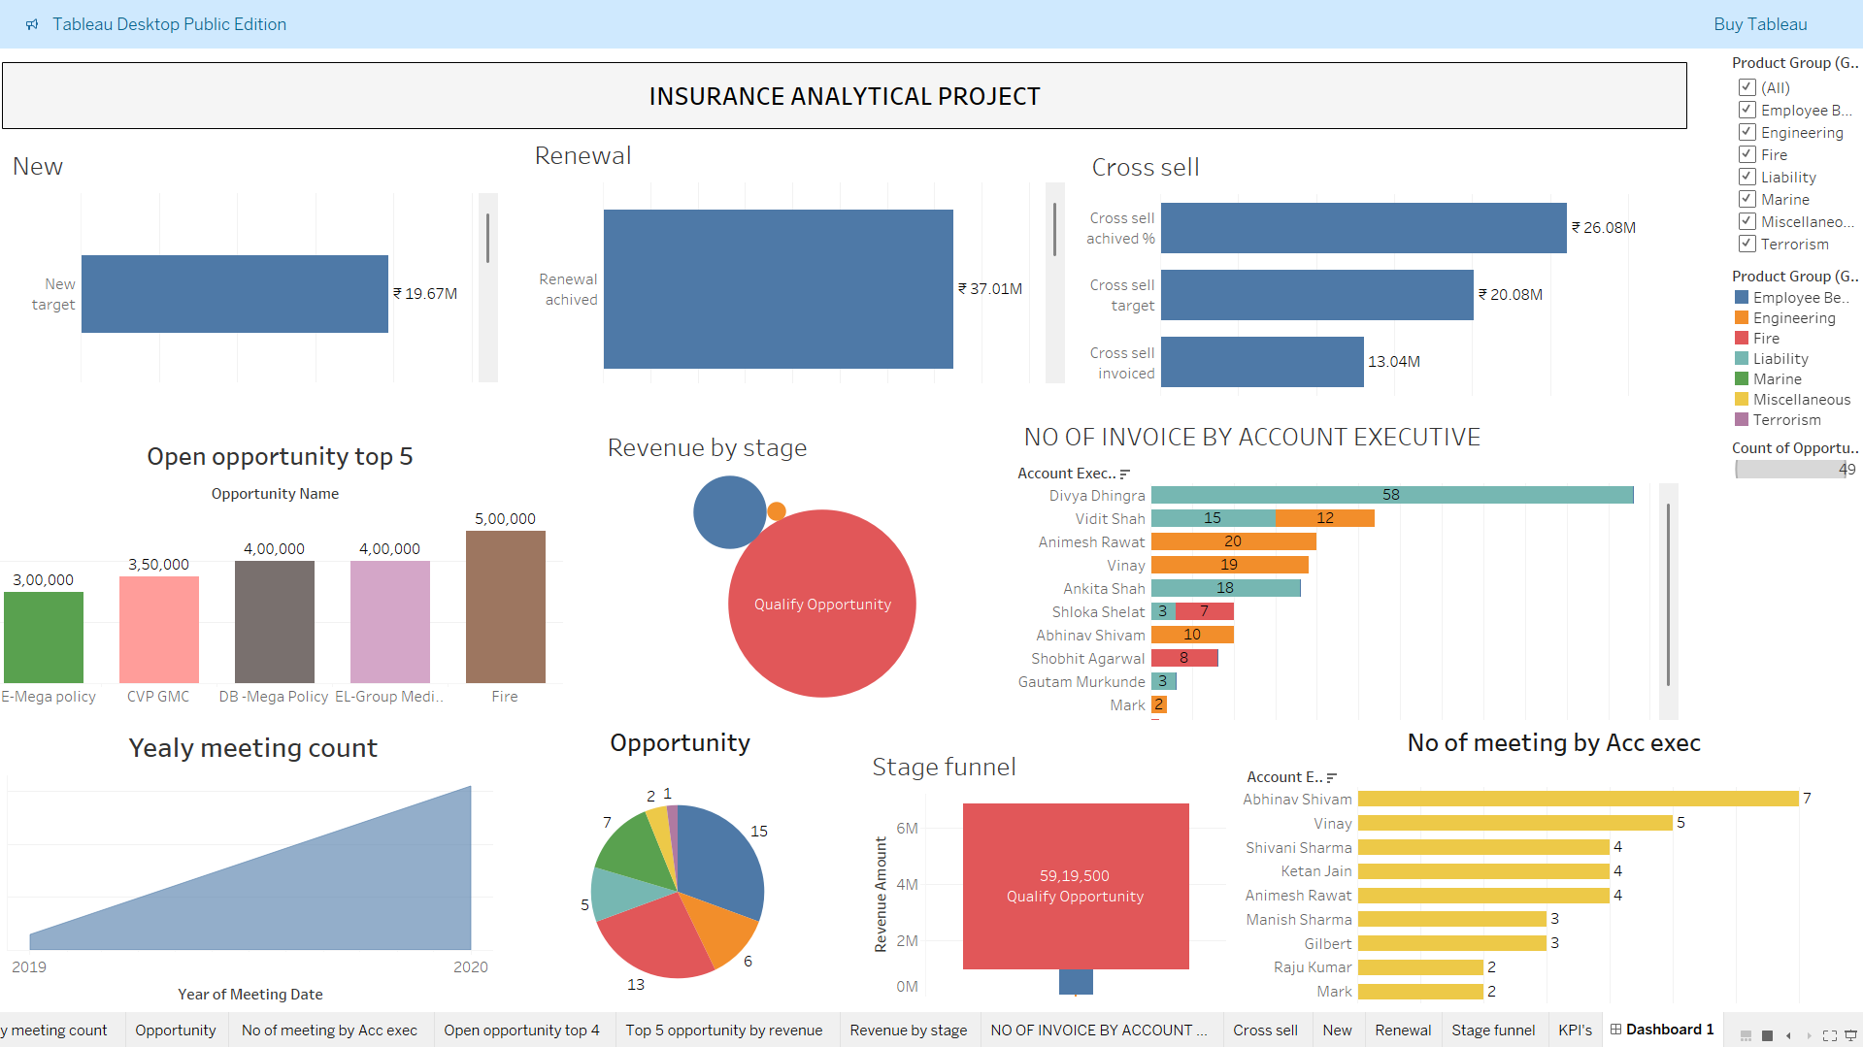
Tableau Dashboard
Data analytics helps in finding patterns, trends, and useful information from raw data. These insights guide organizations to make accurate, faster, and evidence-based decisions, reducing risks and improving business growth.

Slide 10
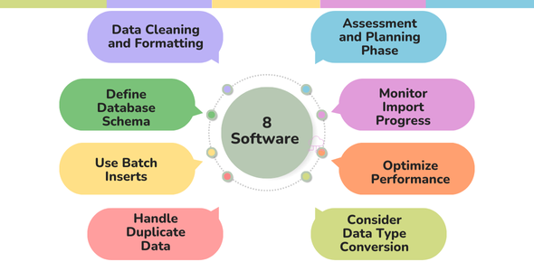
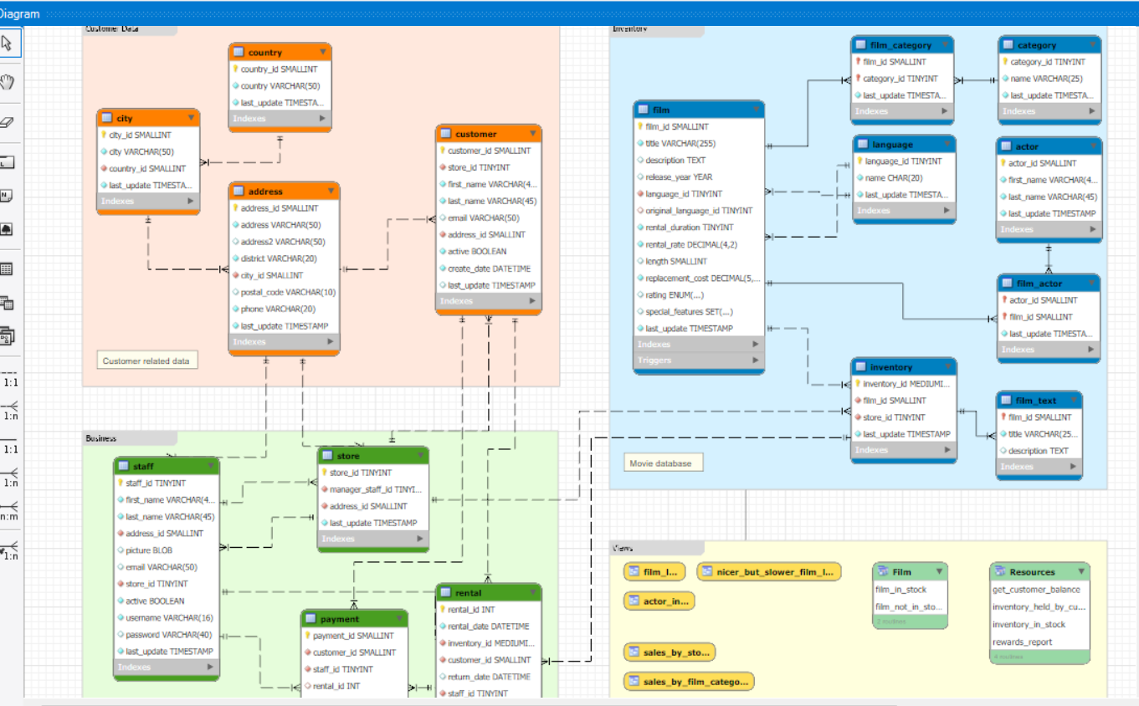
MySQL
Wrote as Script:
We Shown As How We Created..
Step Are Doing In :
Data Modeling Part :

Slide 11
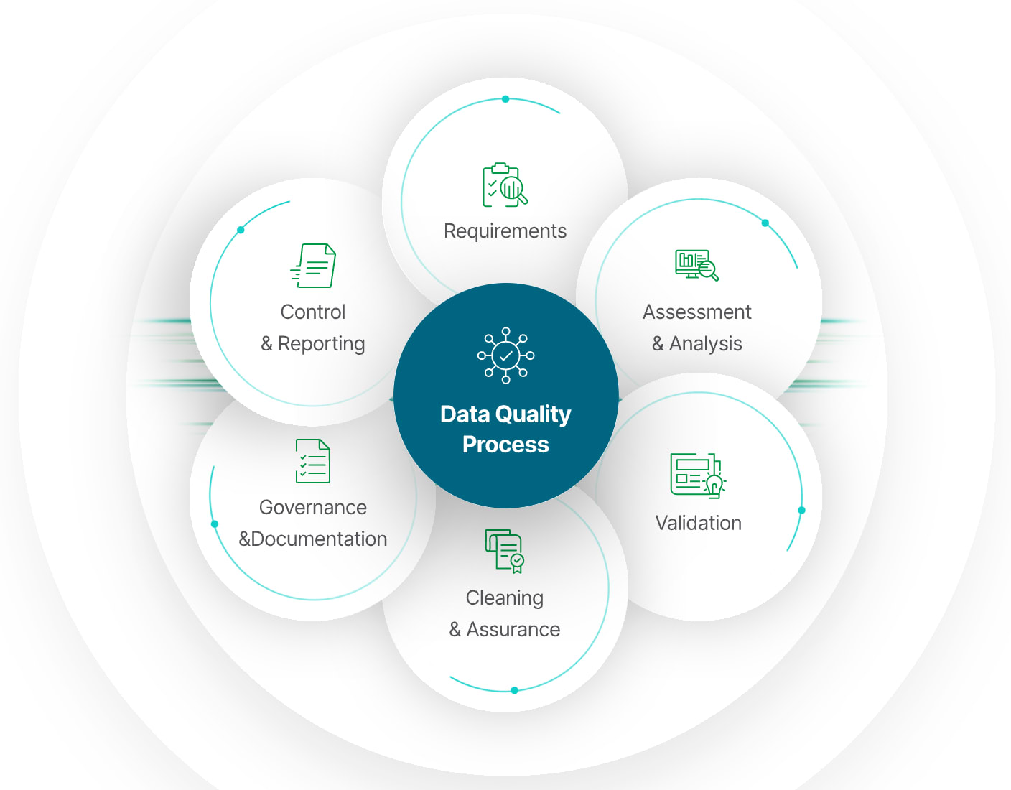
Challenges And Solutions 1 . Data Quality Issues
* Missing Values –
Some rows have blank or null values.
* Duplicate Records –
Same entry appears more than once.
* Inconsistent Data –
Different formats for the same value.
* Outliers/Incorrect Data –
Values that don’t make sense.
* Data Entry Errors –
Typographical mistakes.

Slide 12

2. Integration of multiple data sources
In my project, while integrating multiple data sources, I faced issues like schema mismatches, inconsistent formats, duplicate records, and missing keys. I resolved these by standardizing data, removing duplicates, and ensuring consistency using
[ Excel/MySQL/Power Bi ]. Tableau – Only Visual Process.

Slide 13
Conclusions 1. Summary Of Project Outcomes
* Integrated Multiple Data Sources:
Combined brokerage, fees, invoices, meetings, opportunities, and budgets into a single analytical view.
* Revenue Analysis:
Identified income from Brokerage & Fees transactions across branches, products, and account executives.
* Client & Policy Insights:
Analyzed active vs inactive policies, renewal patterns, and lapse reasons.
* Performance Tracking:
Compared individual budgets vs actual performance of account executives.
* Sales Opportunities:
Monitored pipeline opportunities by stage, premium amount, and revenue contribution.
* Meeting Effectiveness:
Tracked meetings by account executives, clients, and dates to evaluate engagement.
* Key Business Drivers:
Highlighted top-performing branches, solution groups, and revenue-generating clients.
* Data Cleaning & Quality Handling:
Addressed missing values, duplicates, inconsistent formats, and schema mismatches during integration.

Slide 14

Conclusions 2. Solution To Client
KPI’s
1. No of Invoice by Account Exec
2. Yearly Meeting Count.
3.1Cross Sell--Target, Achievement, new
3.1New-Target,Achive,new
3.1Renewal-Target, Achievement, new
4. Stage Funnel by Revenue
5. No of meeting By Account Exe
6. Top Open Opportunity

Slide 15
Conclusions 2. Solution To Client
KPI’s
Explanation :
1. Invoice Management Insight:
Number of invoices handled by executives shows workload distribution.
Solution:
Balance invoice assignments across executives and automate invoice tracking to avoid delays.
2. Client Engagement (Meetings)Insight:
Yearly and executive-level meeting counts highlight engagement levels.
Solution:
Increase frequency of meetings with low-engagement clients and set monthly targets for executives to strengthen relationships.
3. Revenue Growth (Cross Sell / New / Renewal)Insight:
Actual vs Target shows gaps in renewal, cross-sell, and new business.
Solution:
Focus on renewals to secure recurring income. Build cross-sell strategies (bundle policies, promote complementary products).Strengthen new business development with lead tracking.

Slide 16
Conclusions 2. Solution To Client
KPI’s
Explanation :
4. Sales Funnel Optimization Insight:
Stage-wise revenue distribution shows where opportunities are stuck.
Solution:
Provide targeted support to move deals from Qualify → Proposal → Closure, improving conversion rates.
5. Account Executive Performance Insight:
Meeting and revenue data show top and underperformers.
Solution:
Recognize high performers, train/support weaker executives, and align performance with incentives.
6. Top Open Opportunities Insight:
Biggest revenue potential lies in top 5 open opportunities.
Solution:
Prioritize these deals with dedicated teams to maximize closure chances and revenue impact.

Slide 17


